Slide 1

AngularJS Services
Gauthier Peel

Slide 2

AngularJS
Angular Services are LAZY loaded
If you don't explicitly call a service, it won't be created unless you tell Angular to do so
If you never use explicitly e service but want to start it , use the module.run() function :

Slide 3

AngularJS
Konwing Lifecycles as always make your life easier !
BIG rules :
Controllers are instantiated with every change of route ng-route or UI-Router. Controllers are Singleton but not long-lived :
a controller lives the time of the view
Services are singletons that persist through a route change and could be thought of as http session on the server side
=> Services are independent of routes
=> Services could also play the M part Controller being the MV :model data restricted for a specific view
Long lived data could also be stored in local storage :
i.e : User login info
Use : Angular Storage

Slide 4
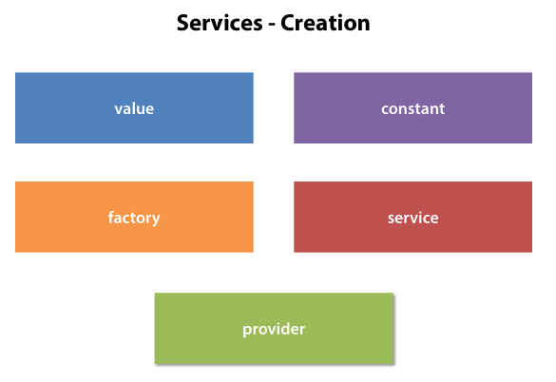
AngularJS

Slide 5
AngularJS
All kind of Services
value
build what you want BUT without any need for injections
constant
factory of objects
pure business API
factory
injection of dependencies : $http …
js styled : revealing module pattern
Angular uses the object returned by the function as Service
service
injection of dependencies : $http …
object styled : this.prop, this.func
angular uses a new on your function
provider
before creation of the service, you can influence the way the service will be created and inject parameters

Slide 6
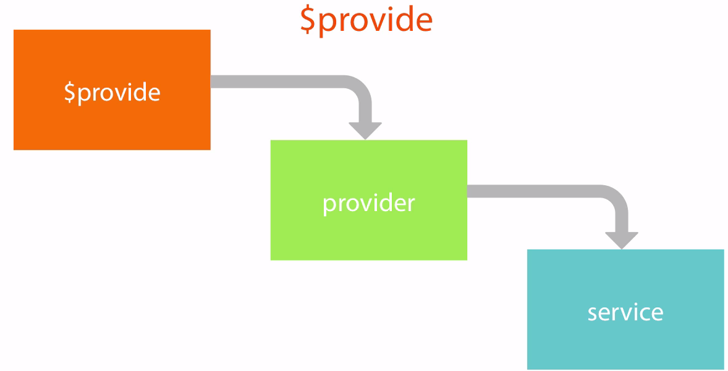
AngularJS
Providers are Objects knowing how to create injectable services

Slide 7
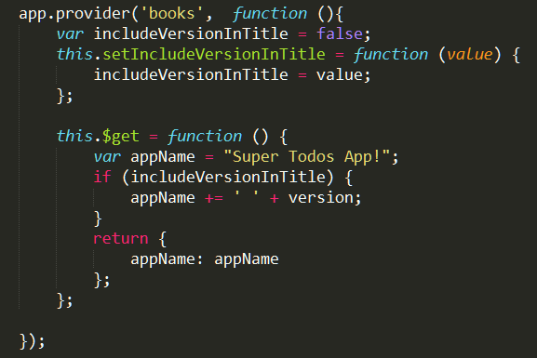

Built as a provider, a service is configurable during Module Configuration Phase
service : 'book' and provider : 'bookProvider'
$get is required
Advantage of the provider syntax : configurable during configuration phase through access to the provider. Here 'bookProvider'
The config methods executes before any application services or controllers are created

Slide 8
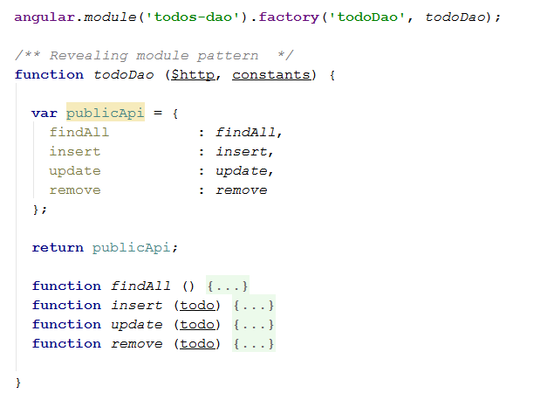
Factory Syntax
The Factory Syntax uses the Revealing Module Pattern, => obvious JS closure

Slide 9
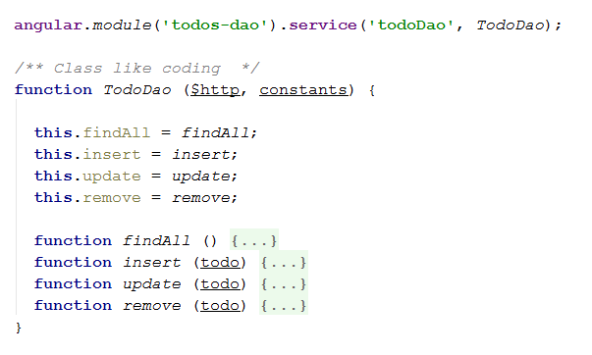
Service Syntax
Angular uses a 'new' on this function, => (not so obvious, but nonetheless real) JS closure

Slide 10
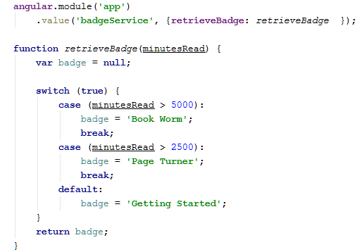
Value Syntax
You can statically build an object but WITHOUT injection

Slide 11
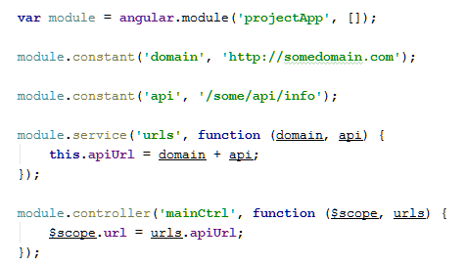
CONSTANT Syntax
The constant function is different, and does not call the provider function.

Slide 12





Summary of Possible injections
Config function
Controller

Slide 13
AngularJS
Starting sequence
Angular Start
app.config()
app.run()
directive's compile functions (if they are found in the dom)
app.controller()
directive's link functions (again if found)
demo : http://jsfiddle.net/ysq3m/
Run blocks
get executed after the injector is created and are used to kickstart the application. Only instances and constants can be injected into run blocks. This is to prevent further system configuration during application run time.
Run blocks are the closest thing in Angular to the main method. A run block is the code which needs to run to kickstart the application. It is executed after all of the services have been configured and the injector has been created.
Run blocks typically contain code which is hard to unit-test, and for this reason should be declared in isolated modules, so that they can be ignored in the unit-tests.

Slide 14
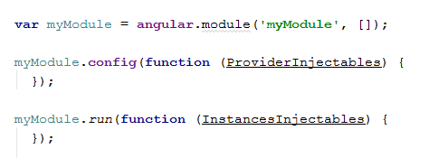
AngularJS
Starting sequence
Examples :
ProviderInjectables : $stateProvider, $urlRouterProvider, MyServiceProvider
InstancesInjectables : $http, MyDao, MyService

Slide 15

Do not create twice the same service name !

Slide 16
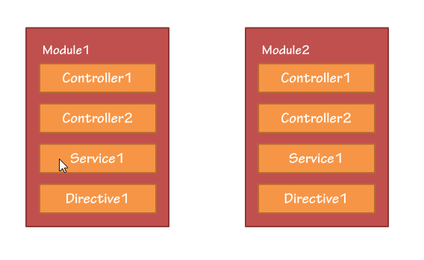
AngularJS
We could think that each Module would have a namespace isolating its Controllers : ( no !
There is NO name isolation between modules, and Controller names are shared. Same goes for Services, Directives ….
Example : Controller1 in Module1 will be the same as Controller1 in Module2.
And if 2 different codes are produced, they will conflict => the last defined will override the first.

Slide 17
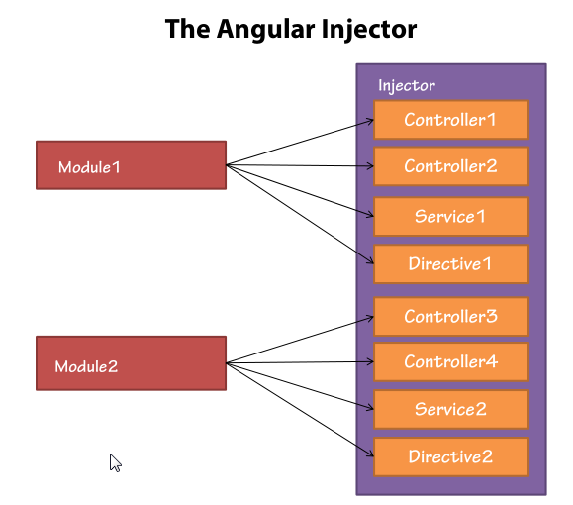
AngularJS
As in Spring, the $injector has singleton instances BY THEIR NAMES, even if you have multiple modules (not often, for simple app)

Slide 18
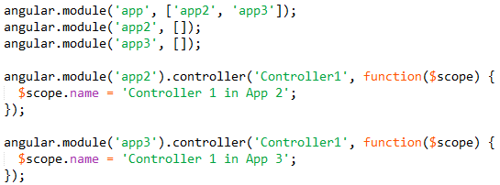
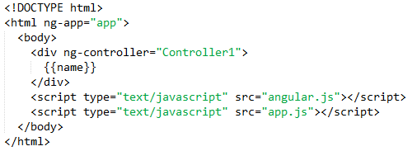

AngularJS
Controller : Override Example
Notes:
angular.module('app', ['app2', 'app3']);
angular.module('app2', []);
angular.module('app3', []);
angular.module('app2').controller('Controller1', function($scope) {
$scope.name = 'Controller 1 in App 2';
});
angular.module('app3').controller('Controller1', function($scope) {
$scope.name = 'Controller 1 in App 3';
});

Slide 19
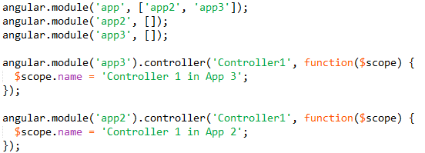
AngularJS
Try changing code definition of Controller1
it changes
No change
Notes:
angular.module('app', ['app2', 'app3']); // changing HERE
angular.module('app2', []);
angular.module('app3', []);
angular.module('app2').controller('Controller1', function($scope) {
console.log('Building Controller1 in app2');
$scope.name = 'Controller 1 in App 2';
});
angular.module('app3').controller('Controller1', function($scope) {
console.log('Building Controller1 in app3');
$scope.name = 'Controller 1 in App 3';
});

